Slide 1
Basic programming

Slide 2
Branching with if
if (logical_expression) { expression_1 … }
if (logical_expression) { expression_1 … } else { expression_2 … }
If logical_expression is TRUE then the first group of expression is executed and the second group of expression is not executed.
Conversely if logical_expression is FALSE then only the second group expression is executed.

Slide 3
If you type
if (logical_expression) { expression_1 …} else { expression_2 …}
then you get an error.
This is because R is believes the if statement is finished before it sees the else part.
That is, R treats the else as the start of a new command, but there is no command that starts with an else.

Slide 4
two are equivalent
if (logical_expression_1){ expression_1 } else {
if (logical_expression_2){ expression_2 } else{
expression_3
}
}
if (logical_expression_1){ expression_1 } else {
if (logical_expression_2){ expression_2 } else{
expression_3
}
}

Slide 5
example : root of quadratic
rm(list=ls()) a0 <- 1; a1 <- 4; a2 <- 5 discrim <- a1^2 - 4*a2*a0 if (discrim > 0) { roots <- c( (-a1 + sqrt(a1^2 - 4*a2*a0))/(2*a2), (-a1 - sqrt(a1^2 - 4*a2*a0))/(2*a2) ) } else if (discrim == 0) { roots <- -a1/(2*a2) } else { roots <- c() }

Slide 6
Looping with for
for (x in vector) { expression_1 … }
where x is a simple variable.

Slide 7
Example : summing a vector
We have a built-in function sum() but for an illustrative purpose:
(x_list <- seq(1, 9, by = 2)) sum_x <- 0 for (x in x_list) { sum_x <- sum_x + x cat("The current loop element is", x, "\n") cat("The cumulative total is", sum_x, "\n") }
cat() : for concatenate
\n : new line

Slide 8
Example : n factorial 1
n <- 6 n_factorial <- 1 for (i in 1:n) { n_factorial <- n_factorial * i } show(n_factorial)

Slide 9
Example : pension
r <- 0.11 # Annual interest rate term <- 10 # Forecast duration (in years) period <- 1/12 # Time between payments (in years) payments <- 100 # Amount deposited each period # Calculations n <- floor(term/period) # Number of payments pension <- 0 for (i in 1:n) { pension[i+1] <- pension[i]*(1 + r*period) + payments } time <- (0:n)*period # Output plot(time, pension)

Slide 10
Example : redimensioning
Program 1 and 2 produce the same result but 1 is faster.
#Program1 n <- 1000000 x <- rep(0, n) for (i in 1:n) x[i] <- i
#Program2 n <- 1000000 x <- 1 for (i in 2:n) x[i] <- i
Program1 of preallocation is faster than Program2 of redimensioning.

Slide 11
Looping with while
while (logical_expression) { expression_1 … }
logical_expression is evaluated first.
If it is TRUE, then the expression in { } is executed.
back to the start of the command.
If logical_expression is FALSE, the loop stop
We can always rewrite a for loop as a while loop.

Slide 12
Example : Fibonacci numbers
rm(list=ls()) F <- c(1, 1) n <- 2 while (F[n] <= 100) { n <- n +1 F[n] <- F[n-1] + F[n-2] } cat("The first Fibonacci number > 100 is F(", n, ") =", F[n], "\n")

Slide 13
Example : compound interest rate
rm(list=ls())
r <- 0.11 # Annual rate period <- 1/12 # Time between repayments (in years) debt_initial <- 1000 # Amount borrowed repayments <- 12 # Amount repaid each period
# Calculations time <- 0 debt <- debt_initial while (debt > 0) { time <- time + period debt <- debt*(1 + r*period) – repayments }
# Output cat('Loan will be repaid in', time, 'years\n')

Slide 14
Vector-based programming
Using vector operations is more efficient computationally.
Sum of the first n squares using loop:
n <- 100; S <- 0 for (i in 1:n) S <- S + i^2 print(S)
Alternatively, using vector operations:
sum((1:n)^2)

Slide 15
Vector-based programming (2)
The ifelse function performs elementwise conditional evaluation upon a vector.
ifelse(test, A, B)
test : logical expression
returns a vector consist of
A : when element of test are true
B : when element of test are true
> x <- c(-2, -1, 1, 2) > ifelse( x>0, "Positive", "Negative") [1] "Negative" "Negative" "Positive" "Positive"

Slide 16
Vector-based programming (3)
pmin and pmax
vectorised versions of the minimum and maximum
> pmin( c(1, 2, 3), c(3, 2, 1), c(2, 2, 2))
[1] 1 2 1

Slide 17
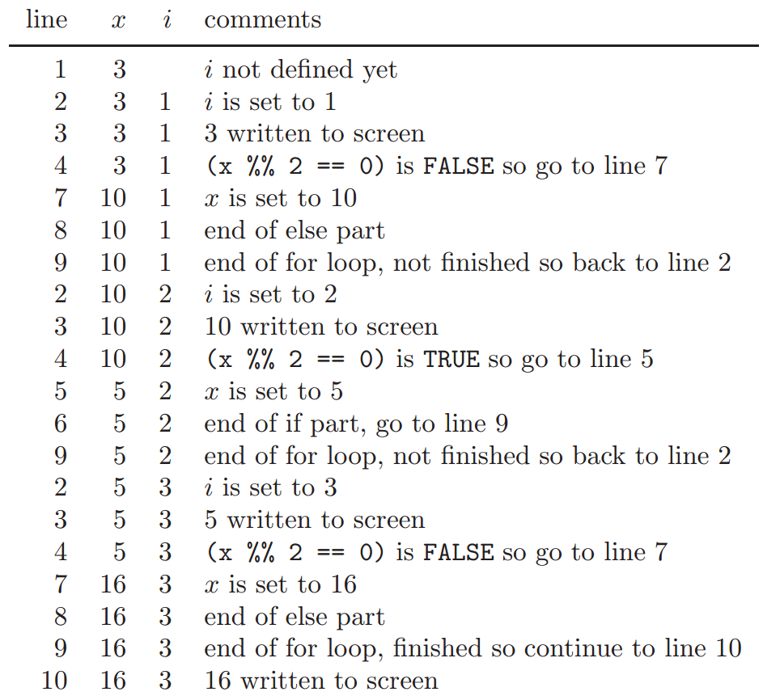
Program flow
x <- 3
for (i in 1:3) {
show(x)
if (x %% 2 == 0) {
x <- x/2
} else {
x <- 3*x + 1
}
}
show(x)

Slide 18
Basic debugging – correcting errors
To find an error or bug, you need to see how your variables change.
include statements like cat("var=", var, "\n")
dry run : using simple starting conditions for which you know what the answer should be.
use short and simple versions of the final program
Use graph and summary statistics.
Careful use of indentation.

Slide 19
Example
x <- 3
for (i in 1:3) {
show(x)
cat("i = ", i, "\n")
if (x %% 2 == 0) {
x <- x/2
} else {
x <- 3*x + 1
}
}
show(x)

Slide 20
Good programming habits
Good programming is clear rather than clever.
in practice, much more time is spent correcting and modifying codes than is ever spent writing them.
Write comments.
Variable name should be descriptive.
Avoid using reserved names of functions
for example, t, c and q are all function names in R
check with exists() function
Use black line to separate sections.

